Slide 1
Development of a Data-driven Model for Estimation of Reservoir Properties (Shale Volume, Porosity, And Fluid Saturations) Using Well Logs: A Case Study of the Volve Field; Norwegian North Sea
Daniel Addokwei Tetteh
July 15, 2021

Slide 2
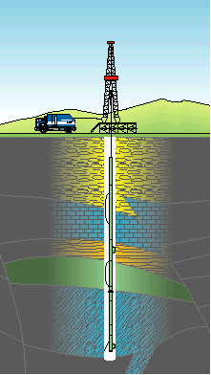
Project Definition
Well logs are discrete or continuous recordings of measurements within a wellbore done with a logging tool or a probe. Standard well logs include Gamma Ray, Resistivity, Bulk Density and Caliper logs amongst others.
RELEVANCE OF WELL LOGS
Geophysical Analysis
Evaluation of rock petrophysical properties.
Estimation of hydrocarbon in place.
Investigation of reservoir pressures.
CHALLENGES WITH WELL LOGS
Inconsistencies associated with indirect measurement of petrophysical properties from well logs
High cost; cumbersome process.
Project Supervisor: Dr. Mathew Beattie
a. Well Logging Truck

Slide 3
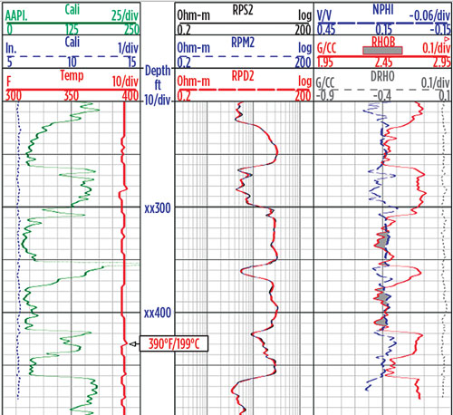
Project Definition
Project Supervisor: Dr. Mathew Beattie
OBJECTIVES
develop a data-driven model to estimate reservoir properties; i.e. shale volume, porosity, and fluid saturation, based on a standard set of well logs
This is a less costly and cumbersome approach compared to conventional methods. It can be further developed to improve its efficiency and be more beneficial to petroleum reservoir engineering and petrophysics.
b. Sample Well Logs

Slide 4
Workflow
Data Acquisition and Description
Data Exploration and Preparation (i.e. identification of trends and patterns, handling missing values and outlier detection and handling, scaling)
Unsupervised Learning- Classification (KMeans and Hierarchical Clustering)
Supervised Learning-Regression (Linear Regression, SVM, KNN, Random Forest)
Comparison of Results and Conclusions

Slide 5

Data Ingestion
DATA SOURCE AND DESCRIPTION
Volve Field; Norwegian North Sea owned by Equinor.
(https://www.equinor.com/energy/volve-data-sharing)
Supplementary data from Society of Petrophysics and Well Log Analysts (SPWLA) PDDA (Petrophysical Data-Driven Analytics) division
KEY CHALLENGES IN DATA AQUISITION
Converting data from well log and other unusable formats (i.e. .LTI, .ASC, .DLIS) from the Equinor data repository to usable formats like .csv.
SPWLA data aided in addressing this problem and maximize time.
SPWLA was in .csv format; more usable. The data was correlated with log plots from Equinor dataset.
Equinor dataset also has relevant supplementary field data which helped in validating the models.

Slide 6
Background (Fundamental Petrophysics Concepts)
Porosity estimation from neutron porosity logs
Porosity estimation from sonic logs
Porosity estimation from bulk density logs
IGR = gamma ray index
GRmin = gamma ray response for the cleanest formation
GRmax = gamma ray response in shale layer
GRlog = gamma ray log value in zone of interest
Vsh= volume of shale
Porosity estimation from bulk density and neutron porosity logs
Estimation of water saturation from resistivity logs
Estimation of Volume of shale from gamma ray logs

Slide 7
Field Description
Volve Field; Norwegian North Sea petroleum field discovered in 1993.
Offshore water depth is about 85m.
Located 5km from North Sleipner Ost Field
Hugin sandstone is the main oil producer
Porosity and permeability values of 0.226 and 2913 millidarcy, respectively.
Peak oil production of 56, 000 barrels per day
Map of the Volve Field in Norway (Sen et al., 2019)

Slide 8
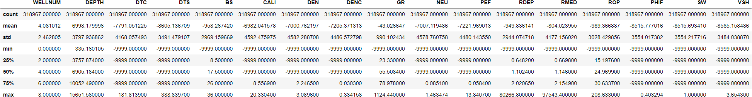
Data Exploration and Preparation
The original dataset had 17 features; 318967 rows and 17 columns
GR - Gamma Ray, unit in API
NEU - Neutron, unit in dec
PEF - Photo-electric Factor, unit in barns/e
RDEP - Deep Resistivity, unit in Ohm.m
RMED - Medium Resistivity, unit in Ohm.m
ROP - Rate of penetration, unit in meters per hour
PHIF - Porosity, a unit equals to the percentage of pore space in a unit volume of rock.
SW - Water saturation
VSH - Shale Volume
WELLNUM - Well, number
DEPTH - Depth, unit in feet
DTC - Compressional Travel-time, unit in nanosecond per foot
DTS - Shear Travel-time, unit in microseconds per foot
BS - Bit size, unit in inch
CAL - Caliper, unit in Inc.
DEN - Density, unit in Gram per cubic centimeter.
DENC - Corrected density, unit in Gram per cubic centimeter.
Statistics of the original dataset

Slide 9
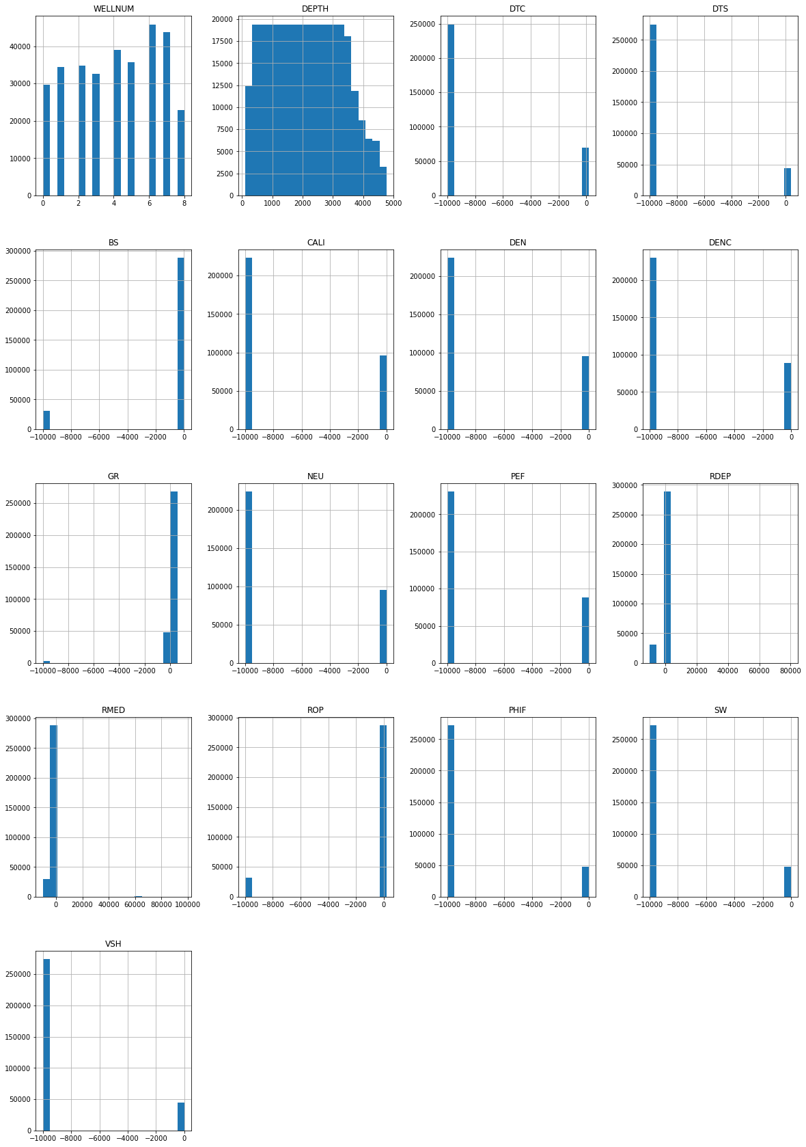
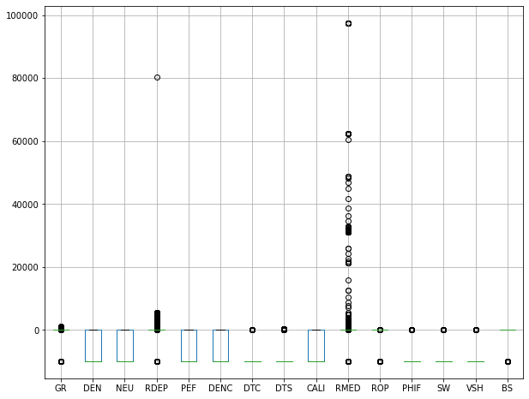
Data Exploration and Preparation
The original dataset is called rawdata
From boxplot, majority of the recorded data in all the features are negative.
Boxplot of original dataset (rawdata)
Histplot of original dataset (rawdata)

Slide 10
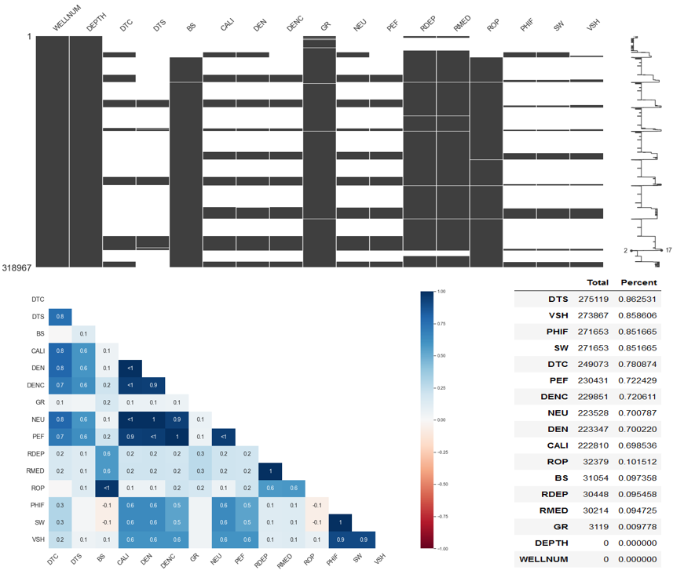
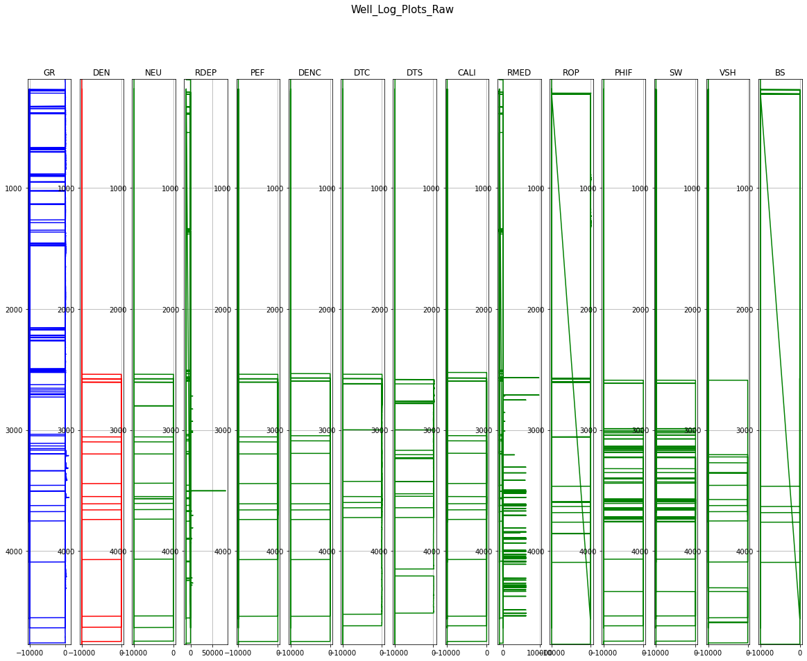
Data Exploration and Preparation
Almost all the features recorded a value of -999 for a greater proportion of their distribution.
From domain knowledge, this -999 values are missing values.
-999 values were converted to NAN values.
Logplot of original dataset
Missing values in original data (rawdata)

Slide 11
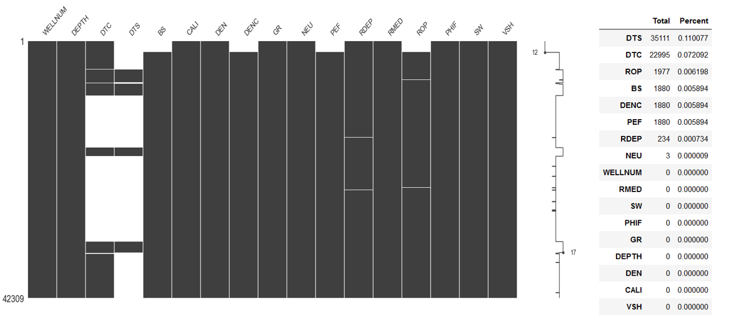
Data Exploration and Preparation
DATA CLEANING
NAN values in all the target variables (Volume of shale (VSH), porosity (PHIF), and water saturation (SW) ) were removed.
The new dataset was named rawdata1 and had 42309 rows and 17 columns.
Some missing data was still present in some of the features.
Depth range for the rawdata1 was 2588.97m to 4744.80m . This is within depths of interest as top of the producing formation ( Hugin formation) is at an average depth of about 2500m across all wells.
Missing values in rawdata1

Slide 12
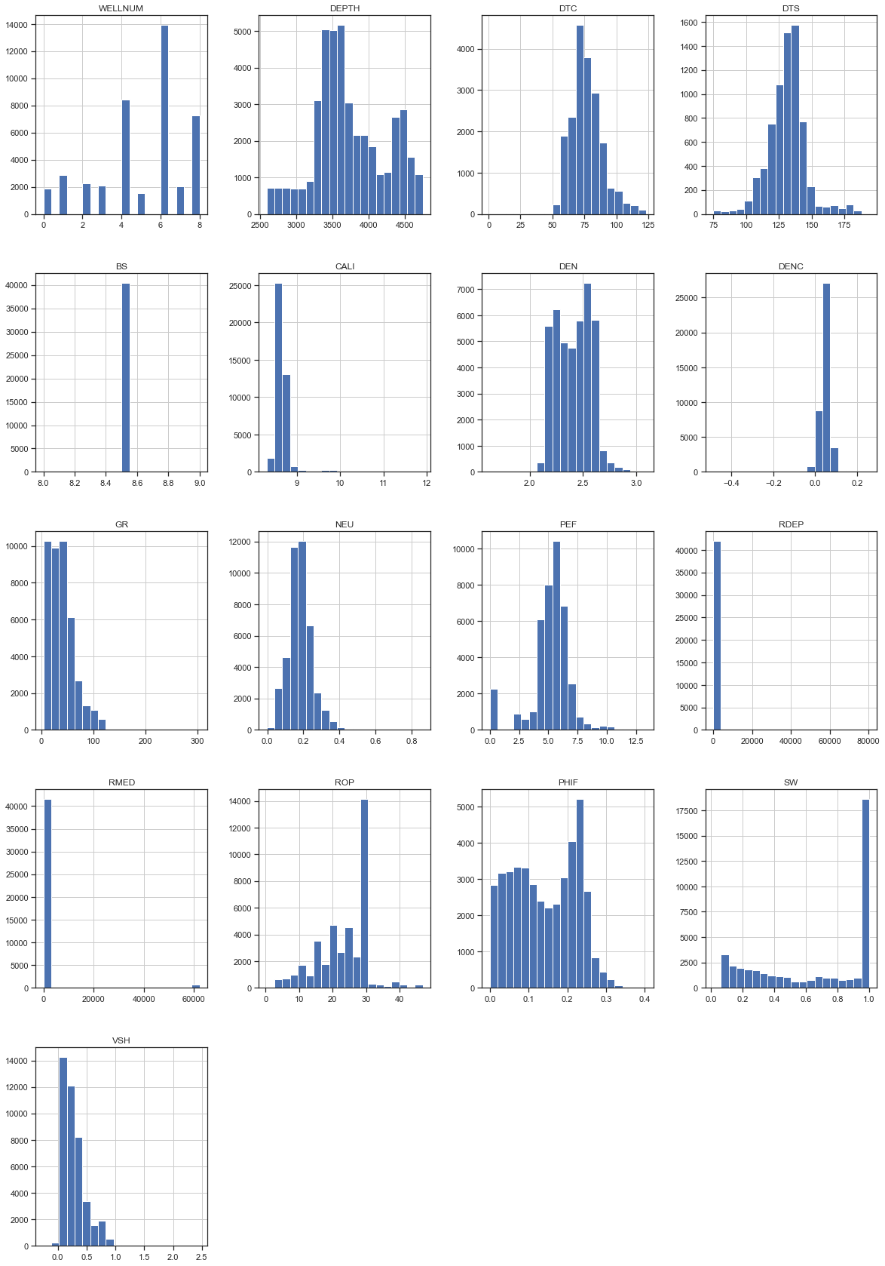
Data Exploration and Preparation
DATA CLEANING
Histplot of rawdata1
Missing values in rawdata1

Slide 13

Data Exploration and Preparation
HANDLING MISSING DATA
Two techniques would be explored
An imputation technique
Use of algorithms that support missing data
IMPUTATION TECHNIQUE
From rawadata1, majority of the missing data was present in these features; DTS, DTC, PEF, DENC, and ROP.
The missing data in these features were predicted using features in the rawdata1 with no missing values.
The method was first employed by by (Akinnikawe et al., 2018) in generating synthetic Photoelectric and Unconfined compressive strength logs from other wireline logs.
Predictors were selected after addressing collinearity based on a Variance Inflation Factor threshold measured.
All other missing values after imputation were removed.
The final dataset after imputation was called rawdata_new.
Rawdata_new had 42072 rows and 15 columns. Well number and bitsize were removed as they were not very important features in predicting target variables.

Slide 14
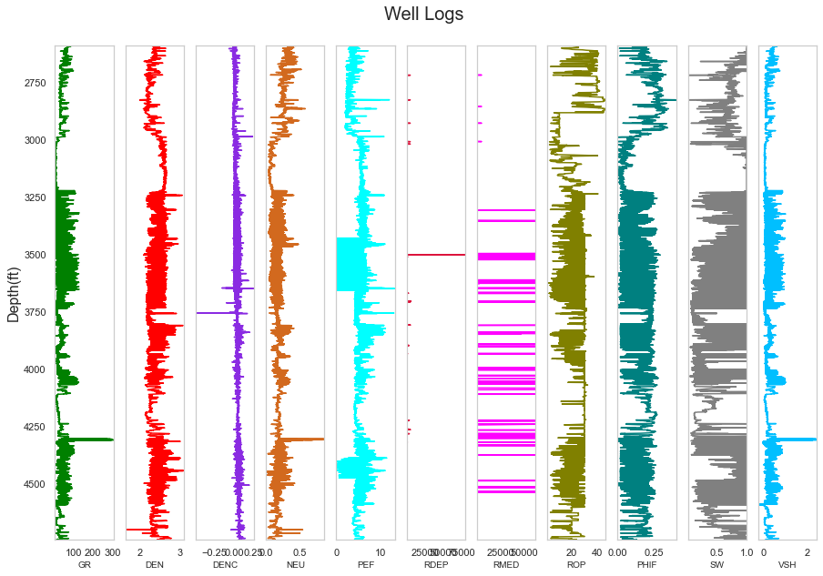
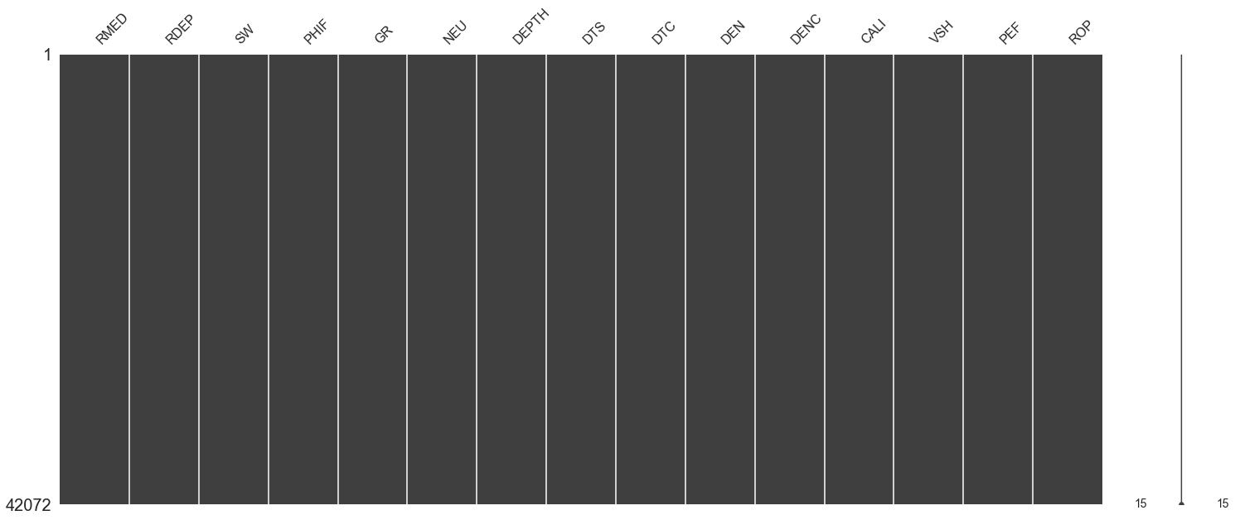
Data Exploration and Preparation
Rawdata_new (with no missing data)
Caveat: Depths are in meters (m) and not feet (ft)

Slide 15
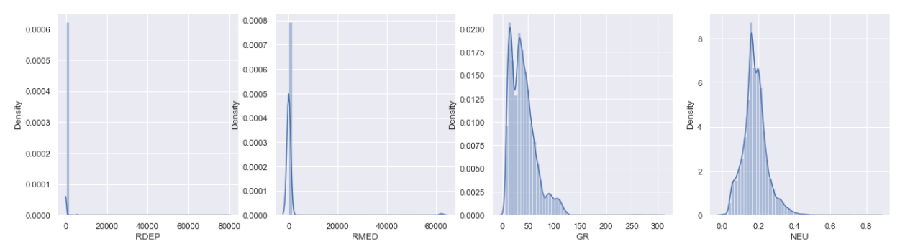
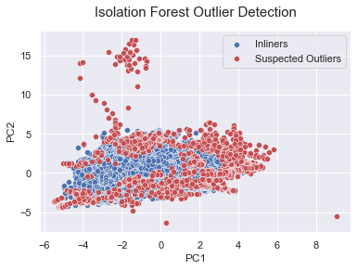
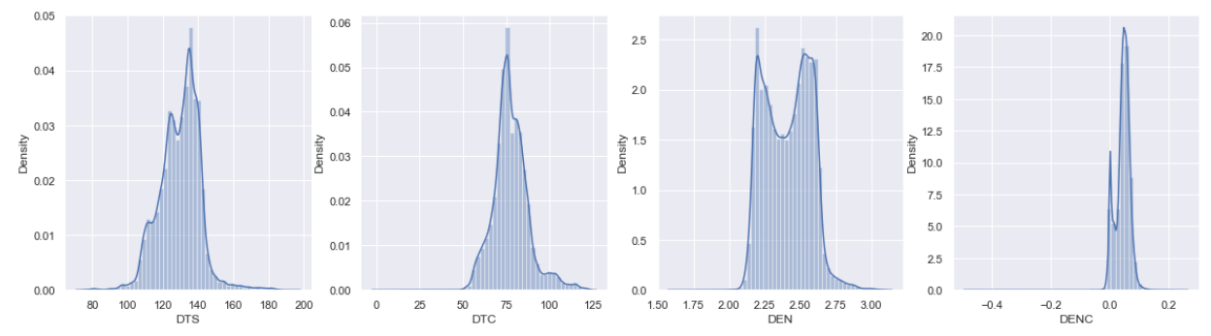
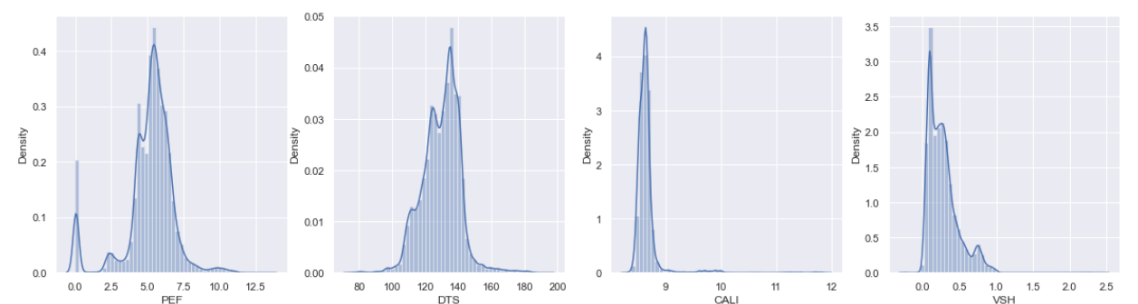
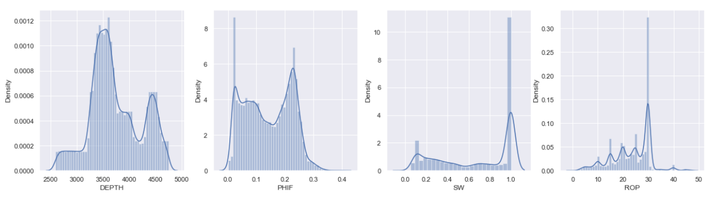
Data Exploration and Preparation
OUTLIER DETECTION AND HANDLING
Isolation forest was used in detecting outliers in rawdata_new. This was further investigated with pairplots and boxplots
Outliers in Rawdata_new
Distribution of features in Rawdata_new

Slide 16
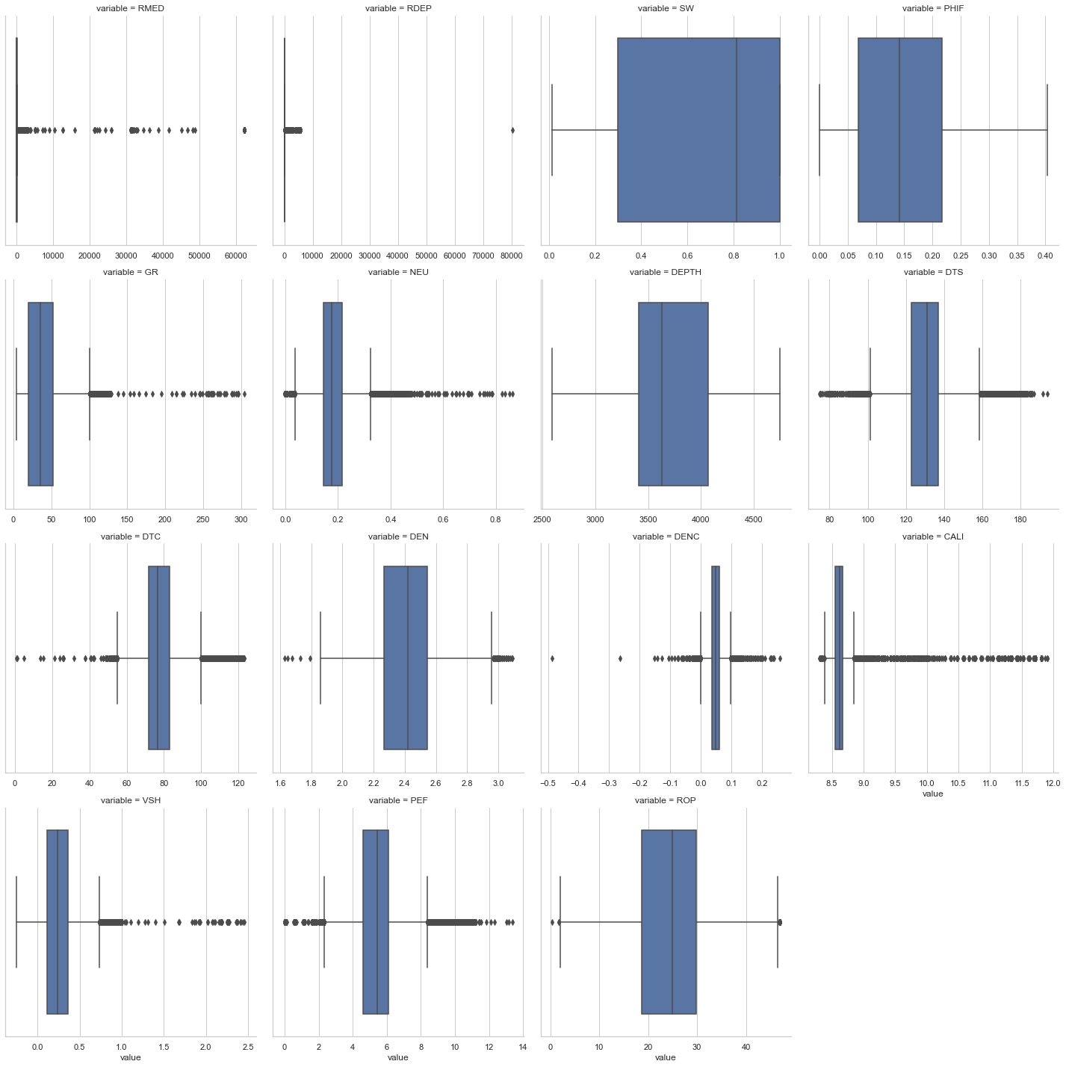
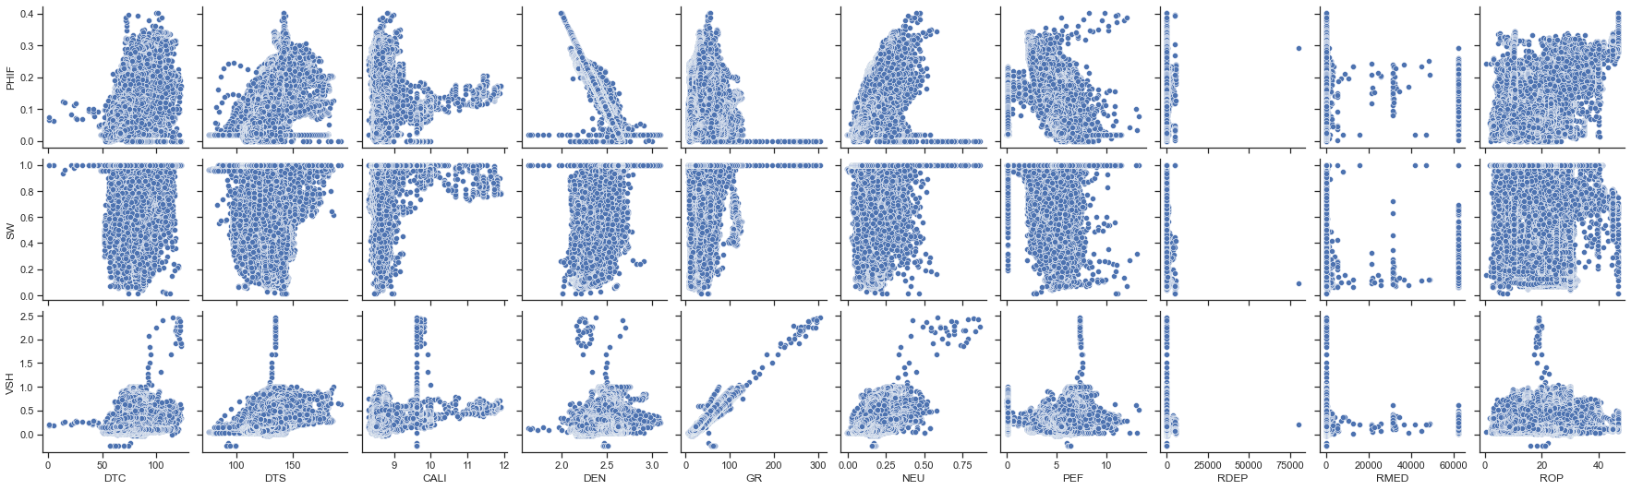
Data Exploration and Preparation
OUTLIER DETECTION AND HANDLING
Pairplot of features in Rawdata_new before outlier removal
boxplot of features in Rawdata_new before outlier removal

Slide 17
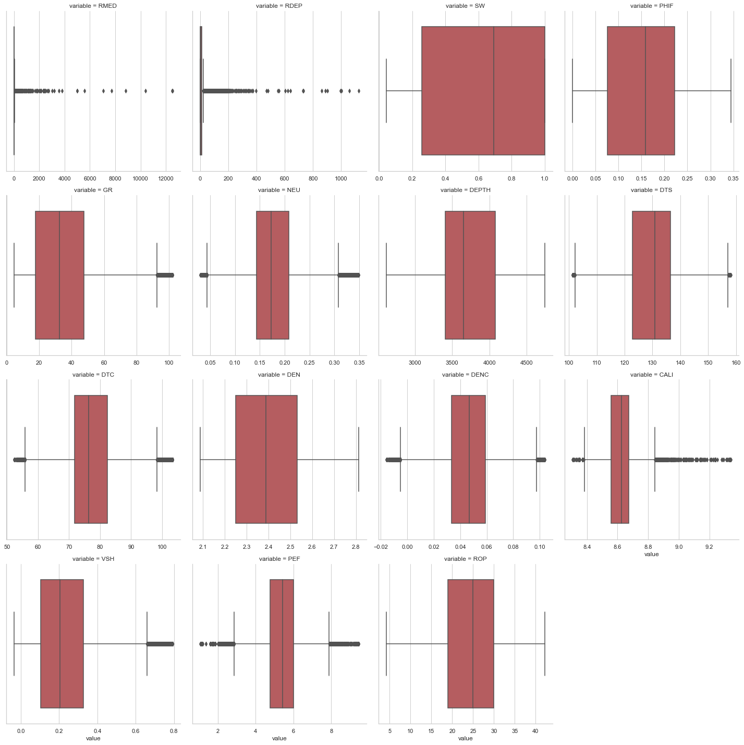
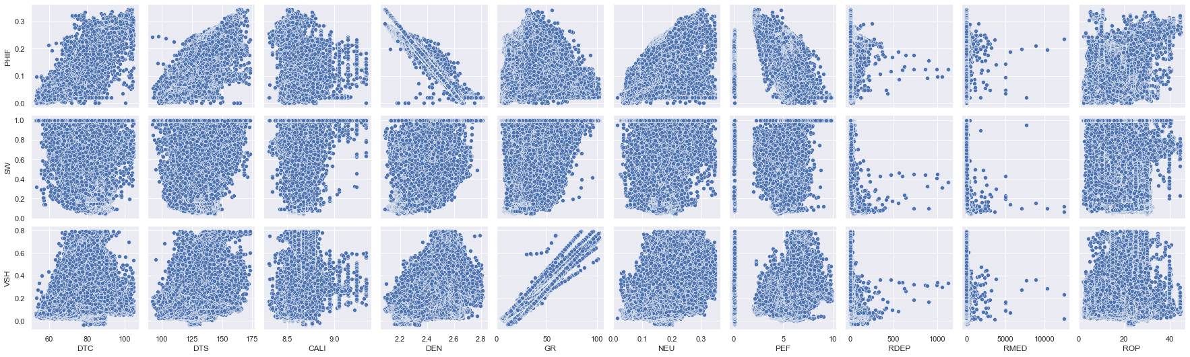
Data Exploration and Preparation
DATA AFTER REMOVING OUTLIERS
The z-score transform was used.
A threshold value of 3 was defined for all features.
Z-scored data was named rawd_zscore
Pairplot of features in Rawd_zscore
boxplot of features in Rawd_zscore

Slide 18

Model Design and Validation
MODEL DESIGN METHODOLGY
MODEL DESIGN VALIDATION
DATA
Three different training datasets would be employed.
Rawdata1: has missing values and models that accommodate missing data would be explored.
Rawdata_new: has no missing values but outliers
Rawd_zscore: has no missing values and outliers addressed using z-score.
TECHNIQUES
Unsupervised Learning:
Clustering of well logs into elctrofacies (KMeans and Hierarchical clustering)
Supervised Learning:
Regression models for predicting target variables. (Linear Regression, Support Vector Machine, K Nearest Neighbors, Radom Forest).
Gradient boosting and other optimization techniques would be used where necessary.
Unsupervised Learning
Depth-match clusters and compare with lithological maps from Equinor dataset to validate performance of unsupervised clustering
Supervised Learning
Train-test split: Training and validation set
Stratification and cross-validation (Grid-search CV)
Statistics of predicted values would be compared with that of training data to ensure consistency as wells are all from the same field.

Slide 19
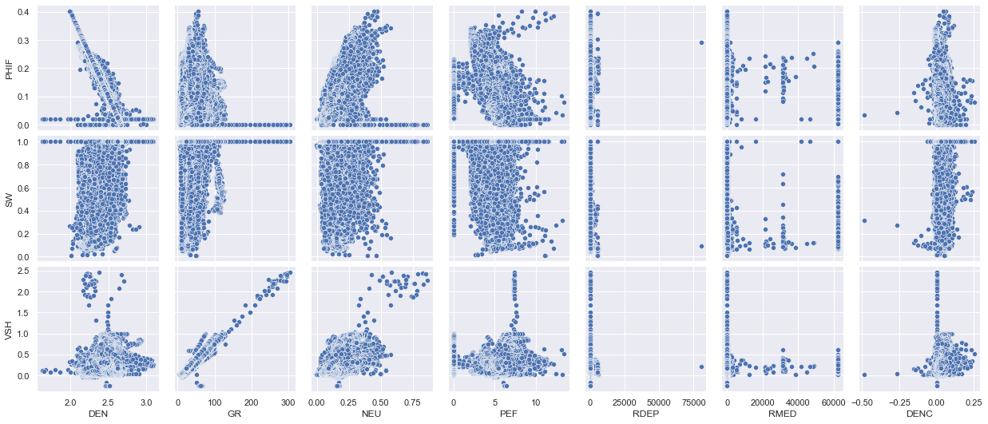
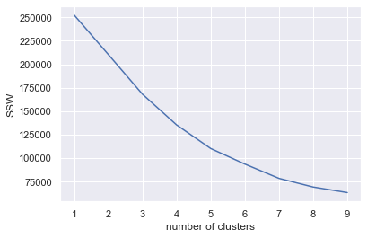
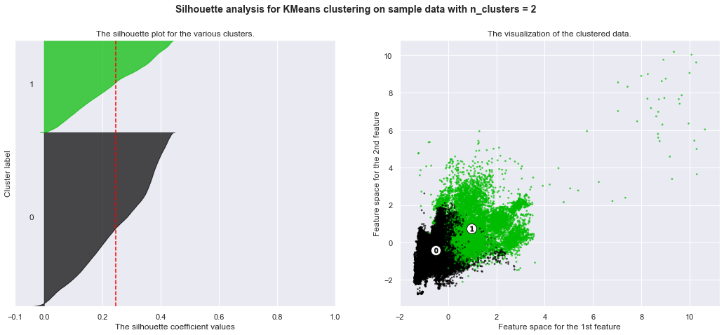
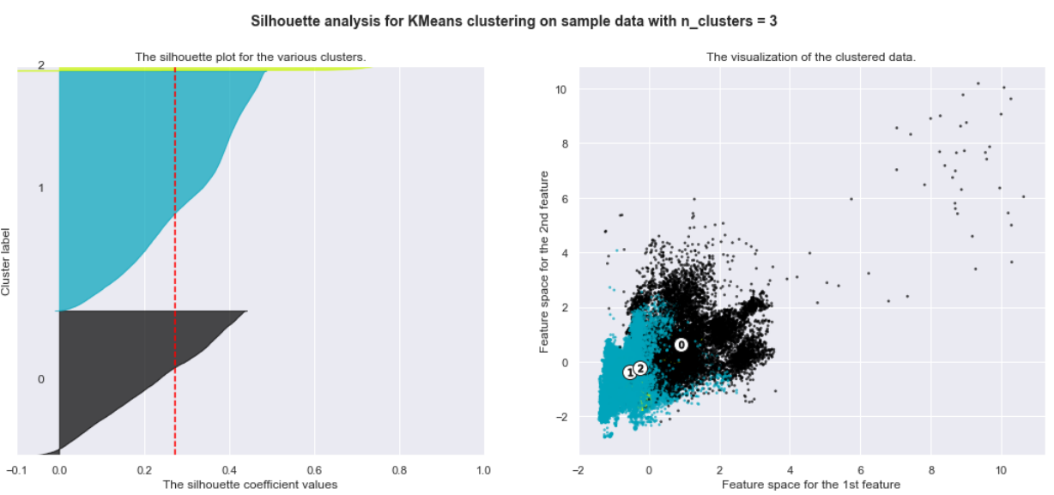
Preliminary Modelling Results (Unsupervised Clustering)
Elbow plot after KMeans Clustering
Pairplot of well logs

Slide 20
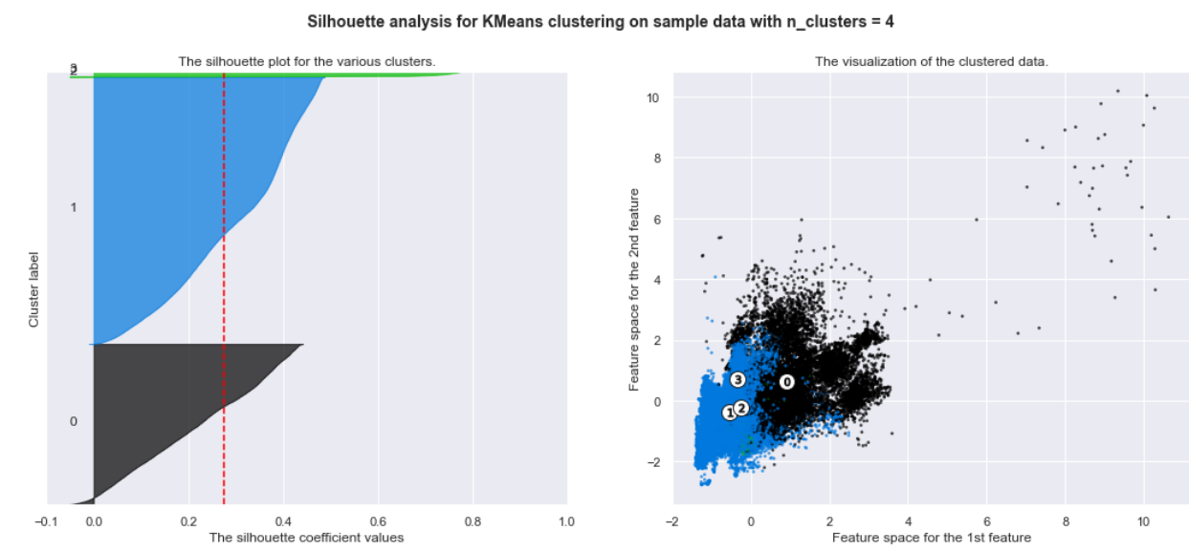
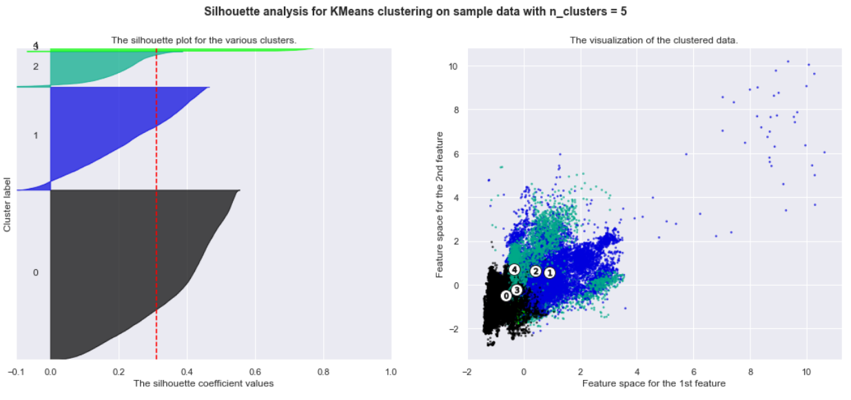
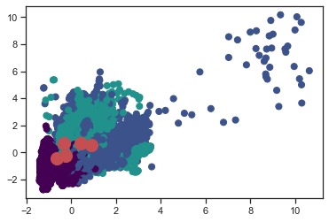
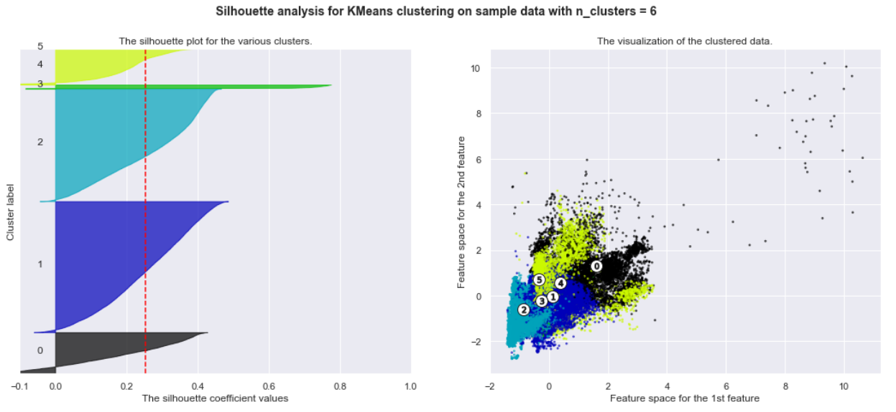
Preliminary Modelling Results (Unsupervised Clustering)

Slide 21
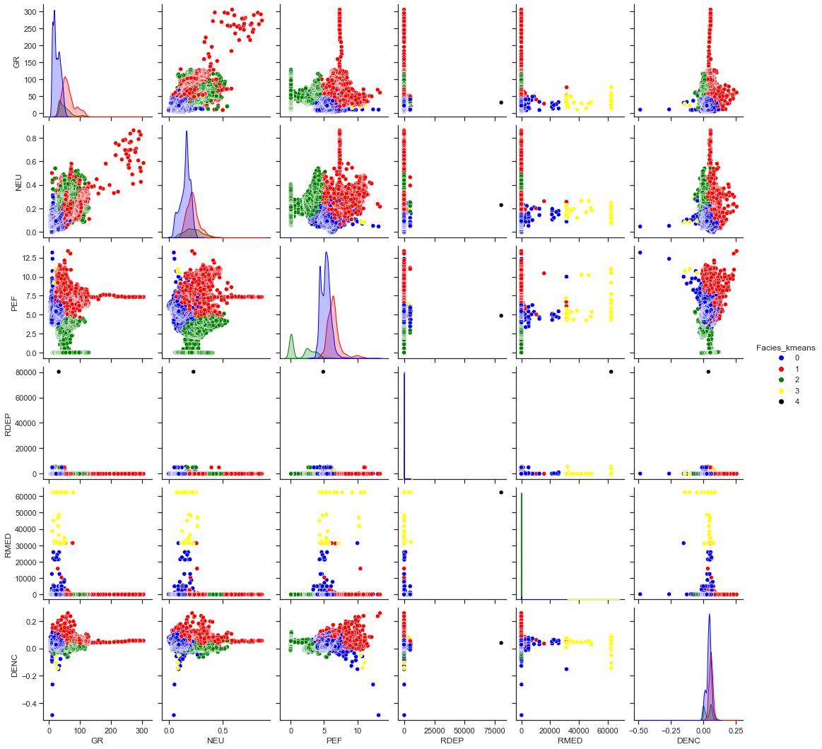
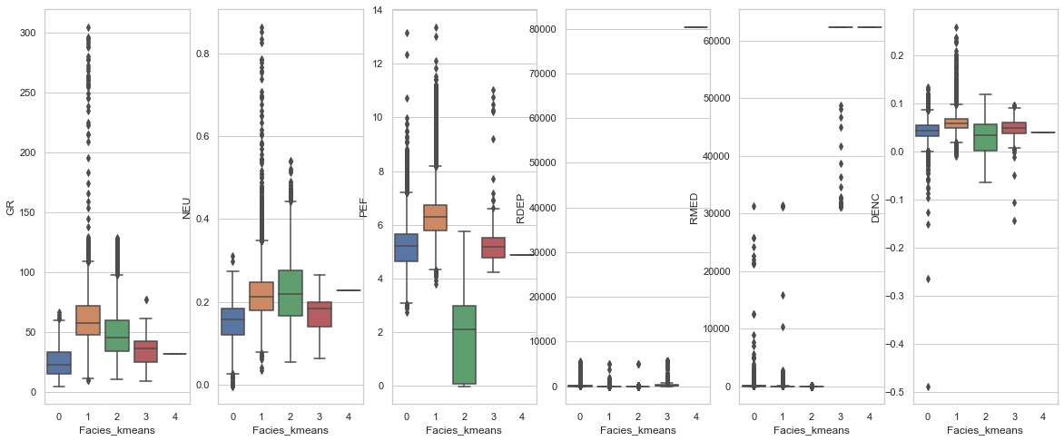
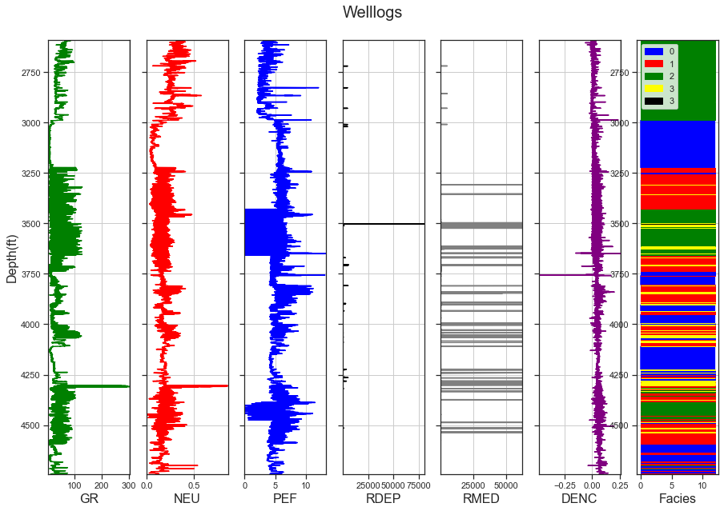
Preliminary Modelling Results (Unsupervised Clustering)

Slide 22
Preliminary Modelling Results (Unsupervised Clustering)
COMMENTS ON PRELIMINARY RESULTS FROM KMEANS CLUSTERING (rawdata_new)
Although the Elbow plot and silhoutte analysis suggest that optimal number of clusters is 5, the clusters are not distinct.
The clusters have different sizes from the silhoutte analysis. Cluster label 4 has very few datapoints.
The boxplots are also not distinct.
The boxplot also shows that RDEP and RMED highly affects the clustering.
RDEP, RMED and other logs were taken out to improve the model results.

Slide 23
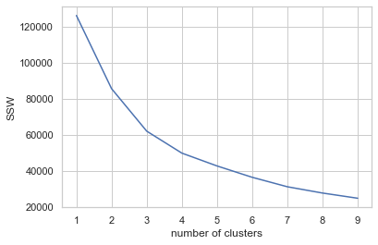
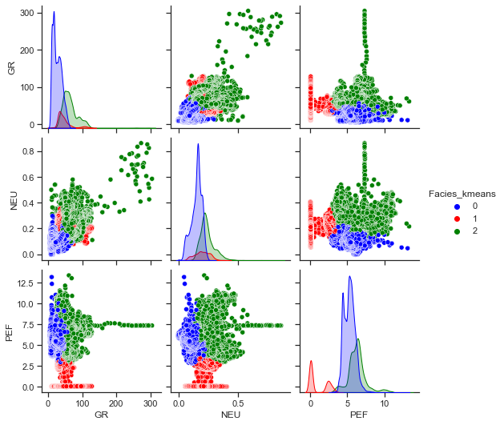
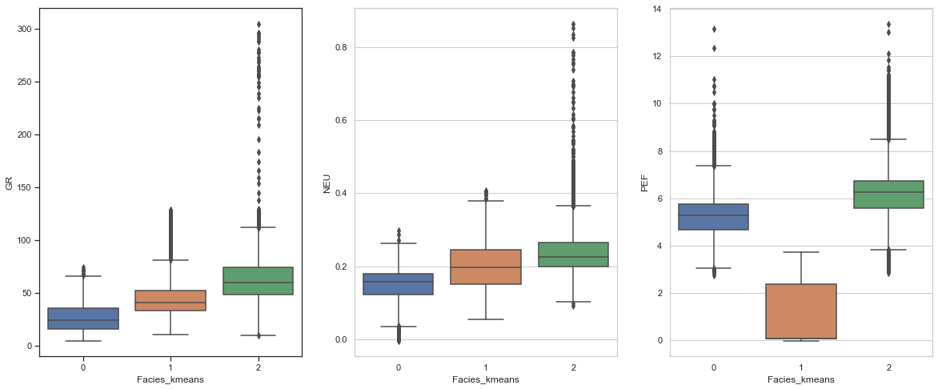
Modelling Results (Unsupervised Clustering)
KMEANS CLUSTERING WITH THREE WELL LOGS (GR, NEU AND PEF) (rawdata_new)
Optimal clusters, 3
Distinct cluster in pair plots
Minimal overlap in boxplots

Slide 24
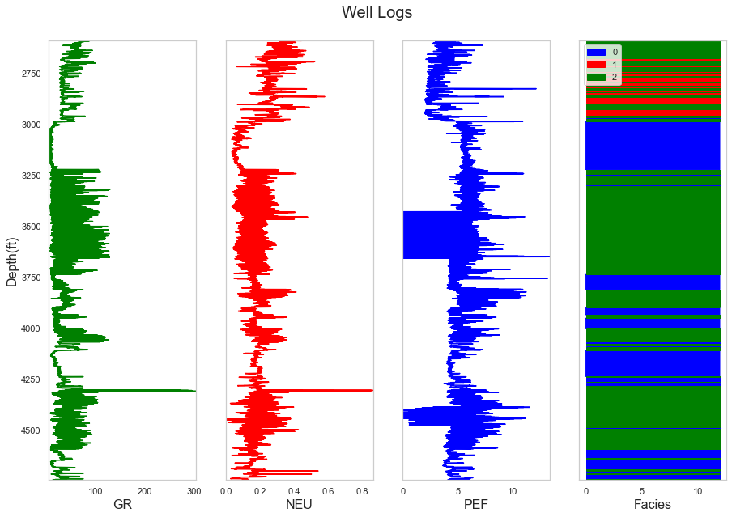
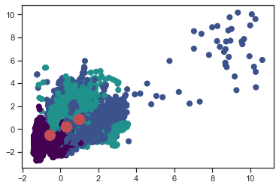
Modelling Results (Unsupervised Clustering)
KMEANS CLUSTERING WITH THREE WELL LOGS (GR, NEU AND PEF)
Distinct cluster centers
Distinct clusters in log plots
Caveat: Depths are in meters (m) and not feet (ft)

Slide 25
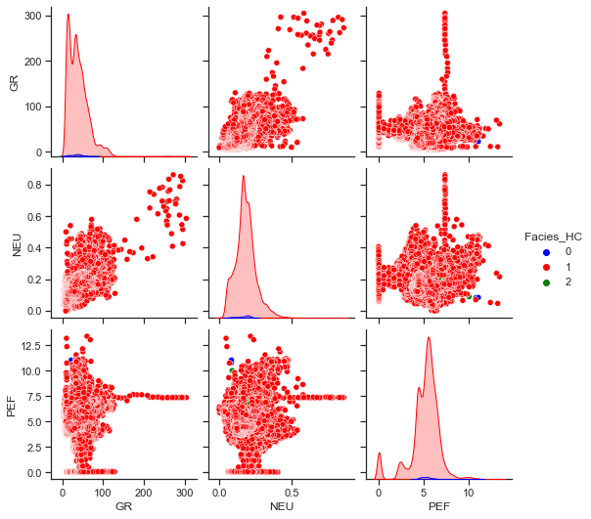
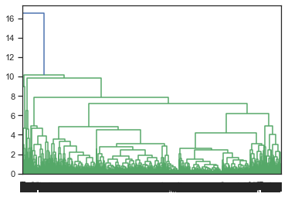
Preliminary Modelling Results (Unsupervised Clustering)
HIERACHICAL CLUSTERING WITH WARD LINKAGE (GR, NEU AND PEF) (rawdata_new)
Poor clustering from dendrogram
Almost all datasets are classified as one cluster

Slide 26
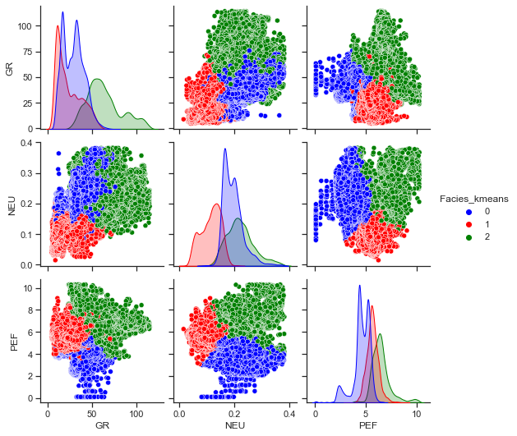
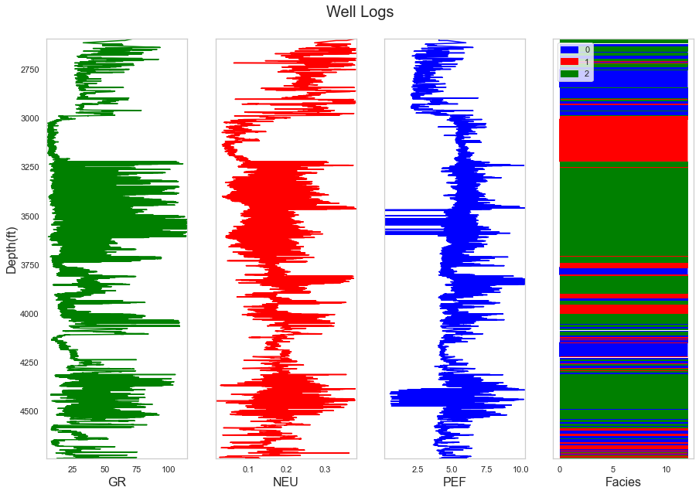
Preliminary Modelling Results (Unsupervised Clustering)
EFFECTS OF OUTLIERS (KMEANS)
Rawdata_new
Rawdata_new
Rawd_zscore
Rawd_zscore
Clusters are more distinct for data with outliers treated compared to data with outliers
Outliers significantly affected the clustering

Slide 27
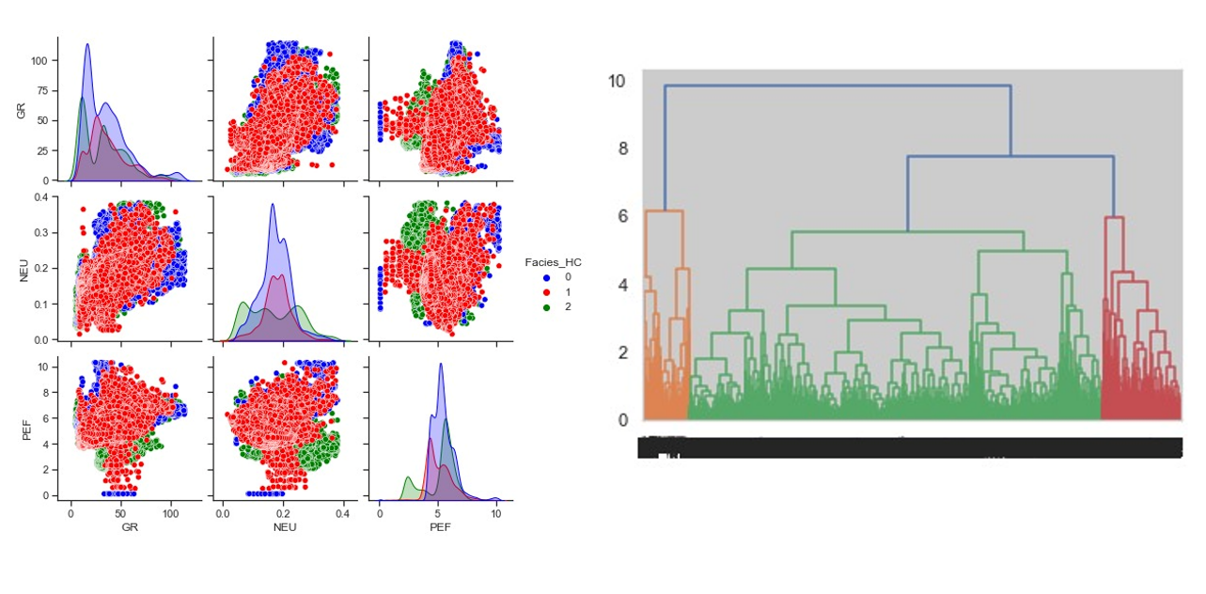
Preliminary Modelling Results (Unsupervised Clustering)
EFFECTS OF OUTLIERS (HIERARCHICHAL)
Rawdata_new
Rawd_zscore
Pairplot had more distinct clusters
Dendogram had more distinct clusters

Slide 28
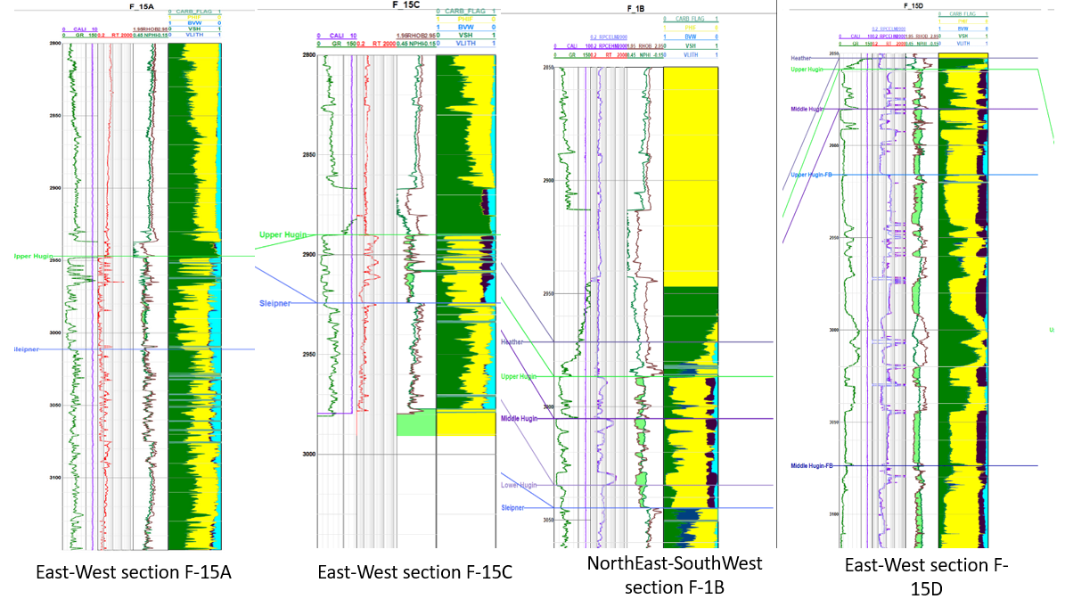
Unsupervised Clustering (Evaluation and Validation)
LITHOLOGICAL CROSS-SECTIONS FROM VOLVE FIELD

Slide 29
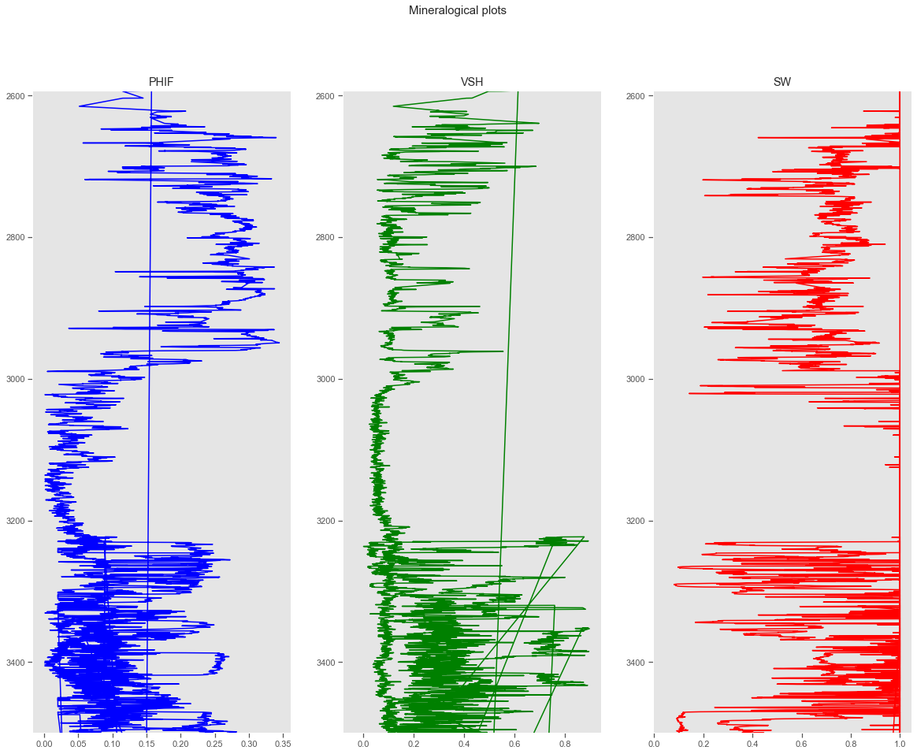
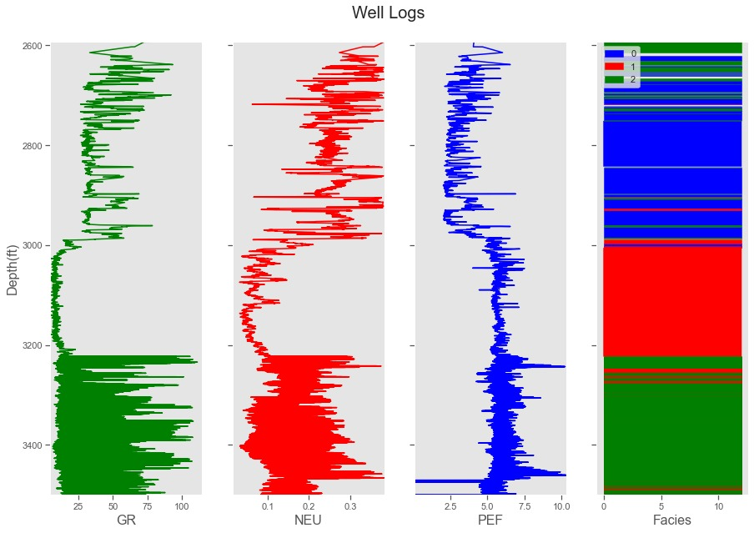
Unsupervised Clustering (Evaluation and Validation)
COMMENTS
2600-2800m; 3200m-3400m-high GR, low PHIF and high VSH: Shaly zone. (cluster 2)
2880m-3000m: High NEU, high PHIF, low VSH, low GR- estimated as sandstone (cluster 0)
3000m-3200m: Similar to 2880m-3000m but with lower porosities. Estimated as sandstone (cluster1)
Caveat: Depths are in meters (m) and not feet (ft)

Slide 30
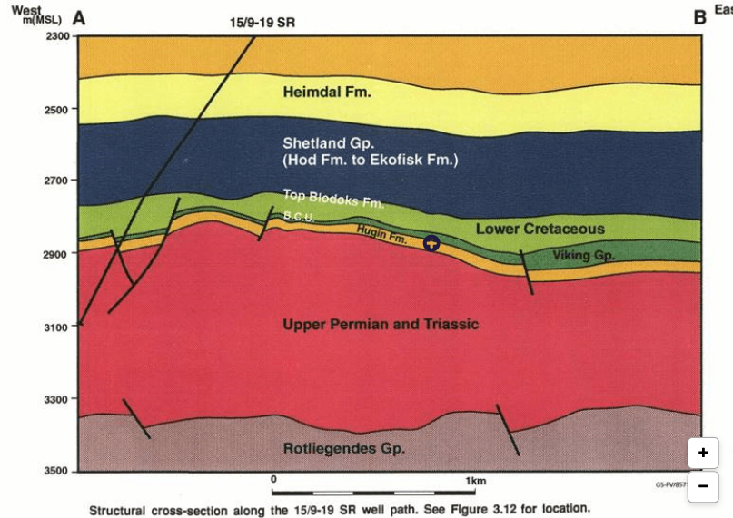
Unsupervised Clustering (Evaluation and Validation)
Depths from 3000-3300m is predominantly Upper Permian and Triassic sandstones (Discover Volve, 2019)
Main producer is the Hugin Sandstone formation (Discover Volve, 2019; Gupta et al., 2020)

Slide 31
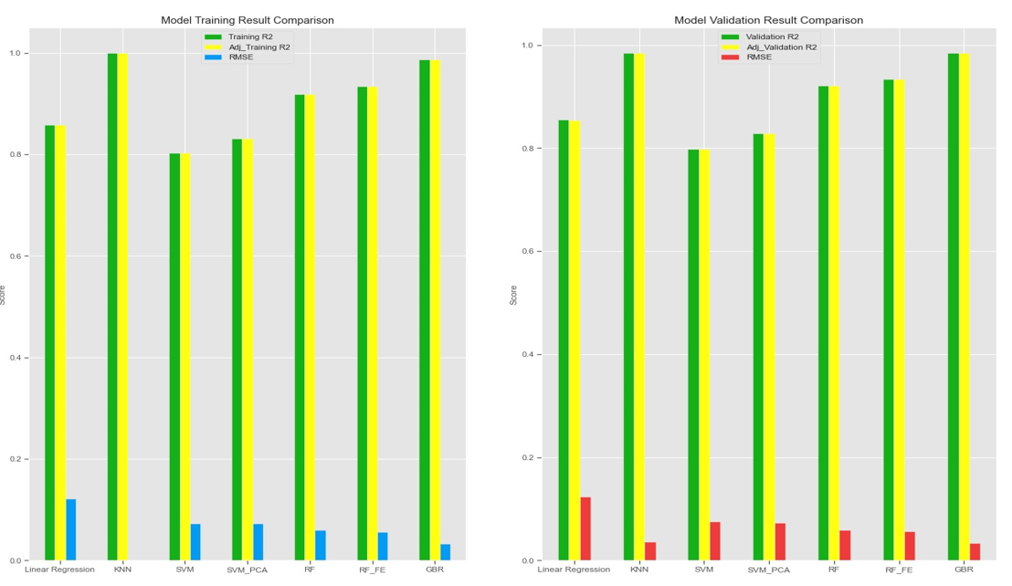
Supervised Learning Results (Regression)
Rawdata_new
Slight over-fitting in KNN and SVM
Random Forest slightly under-fitted the datasets

Slide 32
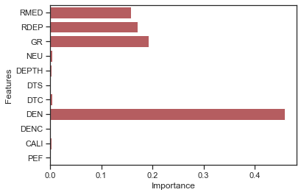
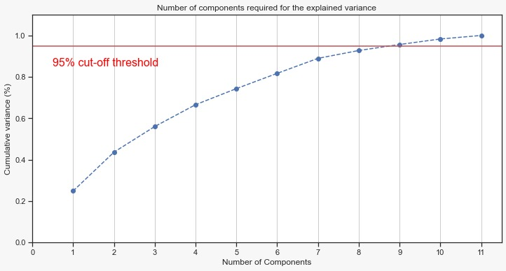
Supervised Learning Results (Regression)
Rawdata_new
Random Forest Feature selection
PCA Explained Variance plot for SVM

Slide 33
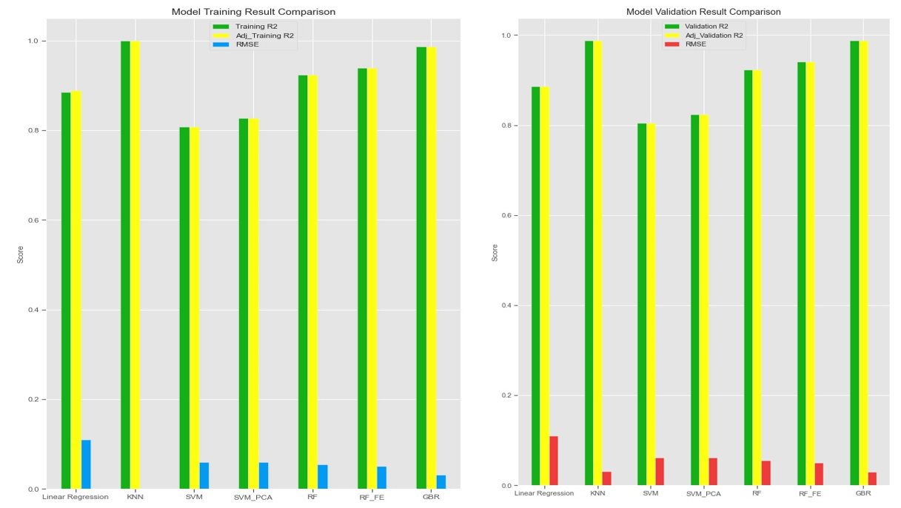
Supervised Learning Results (Regression)
Rawdata_zscore
Overall improvement in model performance when outliers were removed.
Gradient Boost Regression performed optimally.

Slide 34
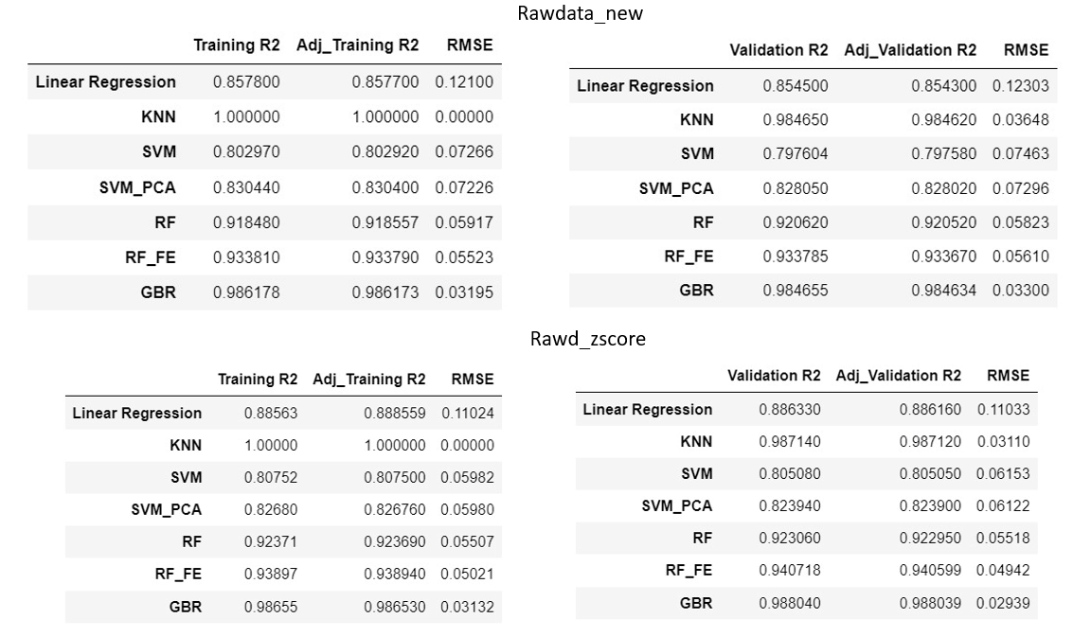

Supervised Learning Results (Evaluation and Validation)
Model Results Summary
Statistics of training and predicted target variables. (A) rawdata_new; (B) rawd_zscore

Slide 35
Conclusion
In this project, an attempt was made to develop a data-driven model to predict three major petrophysical properties based on well logs obtained from the Volve Field. Below are deliverables based on outcomes and results;
A depth-matched plot of clusters (electrofacies) was developed with the KMeans unsupervised clustering algorithm using well logs. These clusters may assist petro physicists and formation evaluation engineers in determining formation lithology at various depths
A data-driven model developed with a gradient boost regressor algorithm that predicts the petrophysical properties with a substantial level of accuracy and minimal errors based on R-squared and RMSE values.
This model seeks to reduce the cost and cumbersomeness involved in estimation of petrophysical properties in oil and gas formation evaluation and reservoir engineering.
Major challenges experienced include extracting all relevant data from data sources available and interpreting supplementary data to corroborate thorough understanding of the model performance.
Also, some challenge was experienced in validating clustering results with cross-sectional lithological plots from field report as this was done in different direction. Unfortunately, the data used in the modelling had no directional component.
In the event of availability of more comprehensive field data, more effective methods can be employed in validating the model performance.
The model can be further explored, and its shortcomings improved to be made deplorable in oil and gas business settings.

Slide 36
REFERENCES
Sen, S., & Ganguli, S. S. (2019, April). Estimation of pore pressure and fracture gradient in Volve field, Norwegian North Sea. In SPE oil and gas India conference and exhibition. OnePetro.
Akinnikawe, O., Lyne, S., & Roberts, J. (2018, July). Synthetic well log generation using machine learning techniques. In SPE/AAPG/SEG Unconventional Resources Technology Conference. OnePetro.
Moradi, S., Moeini, M., Al-Askari, M. K. G., & Mahvelati, E. H. (2016, October). Determination of shale volume and distribution patterns and effective porosity from well log data based on cross-plot approach for a shaly carbonate gas reservoir. In IOP Conference Series: Earth and Environmental Science (Vol. 44, No. 4, p. 042002). IOP Publishing.
Hearst, Joseph R., and Philip H. Nelson. "Well logging for physical properties." (1985).
Mondol, Nazmul Haque. "Well logging: Principles, applications, and uncertainties." In Petroleum Geoscience, pp. 385-425. Springer, Berlin, Heidelberg, 2015.
Equinor Volve Data set; https://www.equinor.com/energy/volve-data-sharing
Sen, S., & Ganguli, S. S. (2019, April). Estimation of pore pressure and fracture gradient in Volve field, Norwegian North Sea. In SPE oil and gas india conference and exhibition. OnePetro
Gupta, I., Tran, N., Devegowda, D., Jayaram, V., Rai, C., Sondergeld, C., & Karami, H. (2020). Looking ahead of the bit using surface drilling and petrophysical data: Machine-learning-based real-time geosteering in Volve field. SPE Journal, 25(02), 990-1006.
Doveton, J. H., & Merriam, D. F. (2004). Borehole petrophysical chemostratigraphy of Pennsylvanian black shales in the Kansas subsurface. Chemical geology, 206(3-4), 249-258.
Archie, G. E. (1952). Classification of carbonate reservoir rocks and petrophysical considerations. Aapg Bulletin, 36(2), 278-298.
Moore, William R., Y. Zee Ma, Jim Urdea, and Tom Bratton. "Uncertainty analysis in well-log and petrophysical interpretations." (2011): 17-28.
Discover Volve. 2019. https://discovervolve.com/2019/07/18/the-seismic-interpretationand-the-formations/

